Slide 1
CREDIT RISK PROJECT
GROUP - 14
SACHIN JAIN: SXJ230042
DHEERAJ RAHUL REDDY PIDURU- DXP230050
KOTA MANASSEH JESRUN - MXK230047

Slide 2
EXECUTIVE SUMMARY
Predicting Profits, Minimizing Risk: Let ML Lead Your Credit Strategy
Aggressive Strategy: A high-reward approach, targeting maximum returns by taking on higher-risk customers with potentially higher default rates.
Conservative Strategy: A lower-risk approach, focusing on safer customers to maintain stable returns with minimized default risk.

Slide 3
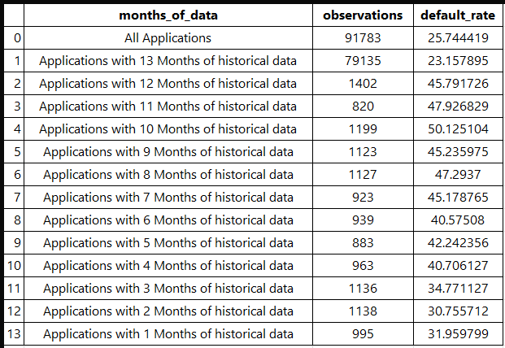
Data
Why Data From April 2017- 2018?
Capturing Full Financial Year Seasonality
Pre-Pandemic Stability for Reliable Predictions

Slide 4
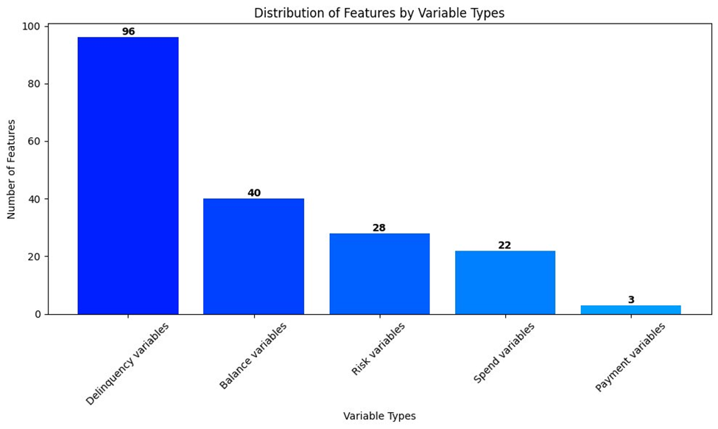
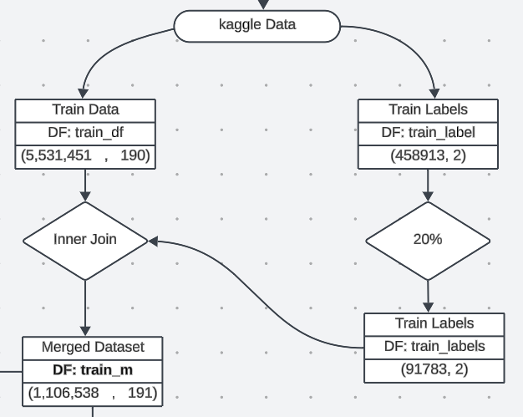
Features

Slide 5
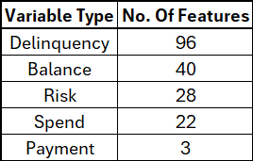
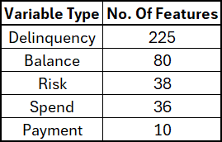
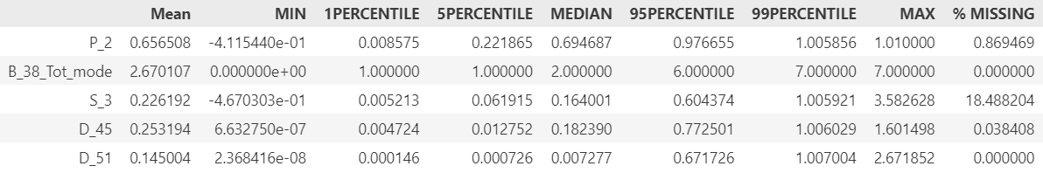
Feature Engineering
Before
After
Aggrigation on Numeric:
Mean on 30 days, 90 days and 180 days for all numeric variables
Aggrigation on Categorical:
Mode of each category for each customer across all the available data.

Slide 6
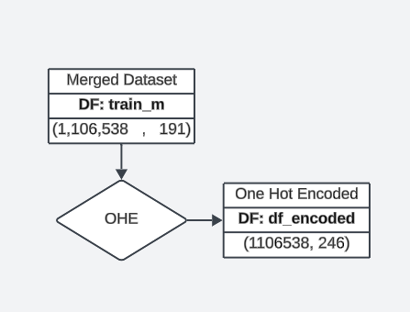
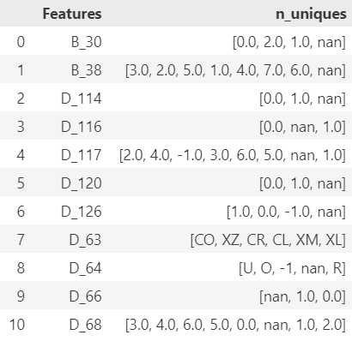
Data Processing / One-Hot Encoding.
55 new features were added after one hot encoding

Slide 7
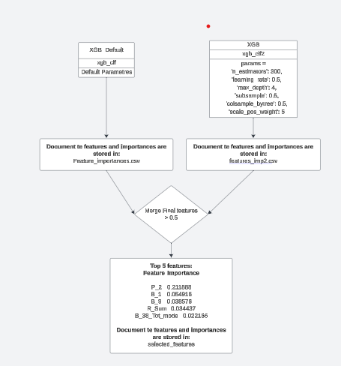
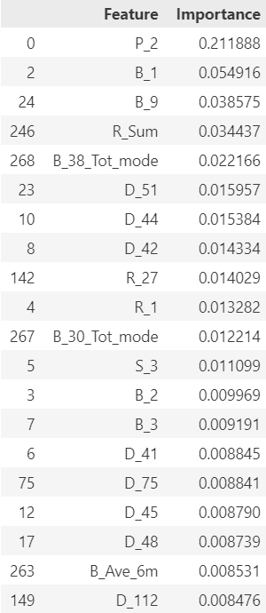
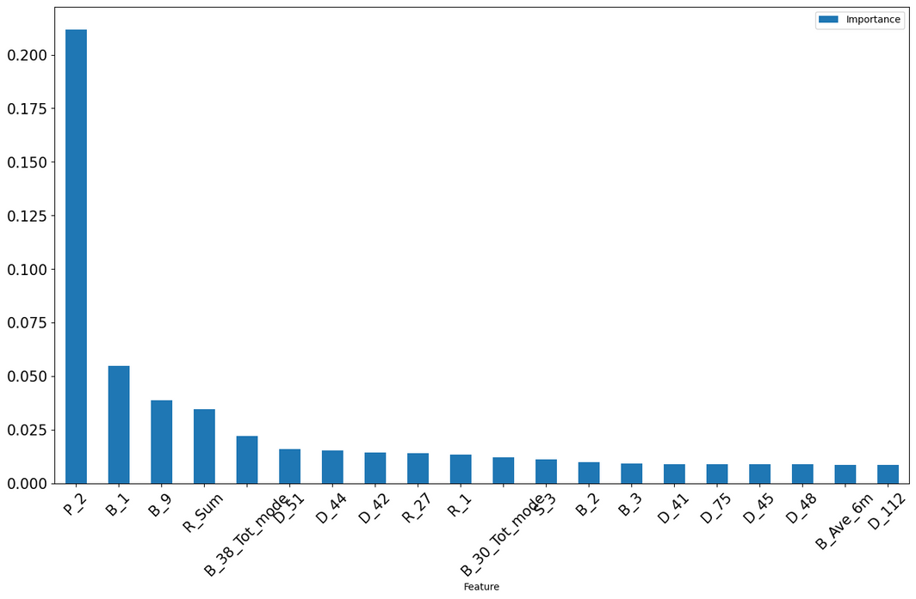
Feature Selection

Slide 8
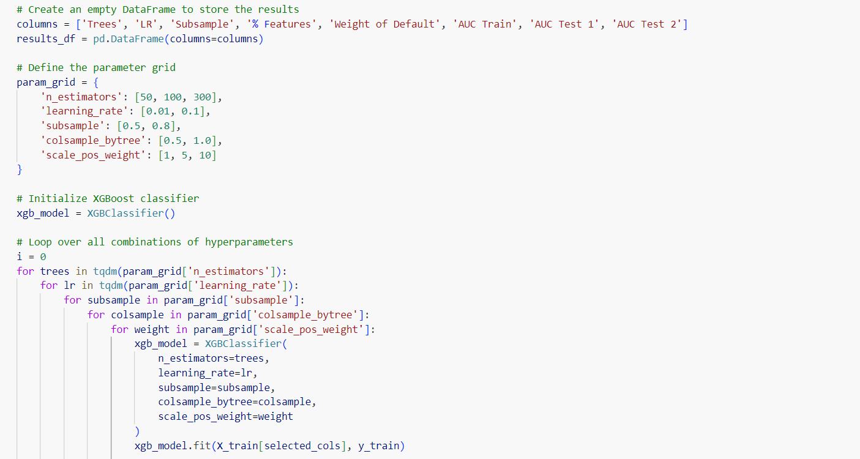
XGBOOST - GRID SEARCH.
In our XGBoost model, we optimized key parameters—n_estimators, learning_rate, subsample, colsample_bytree, and scale_pos_weight—to balance performance and efficiency for predicting credit risk. Our grid search trained 72 models, exploring configurations that tested model complexity, class imbalance handling, and feature selection.

Slide 9
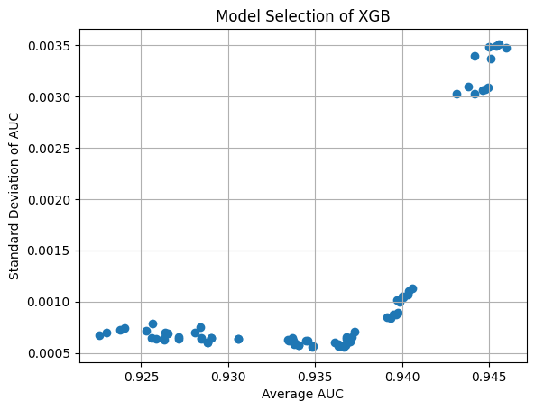
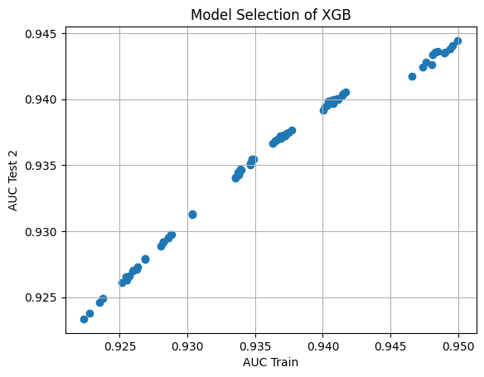

XGBOOST - GRID SEARCH
Our goal is to select a model with the highest average AUC and lowest Std AUC.

Slide 10
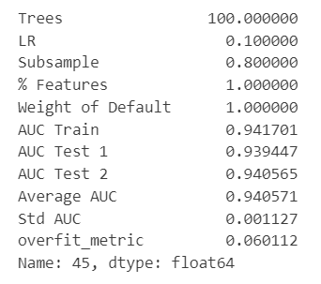
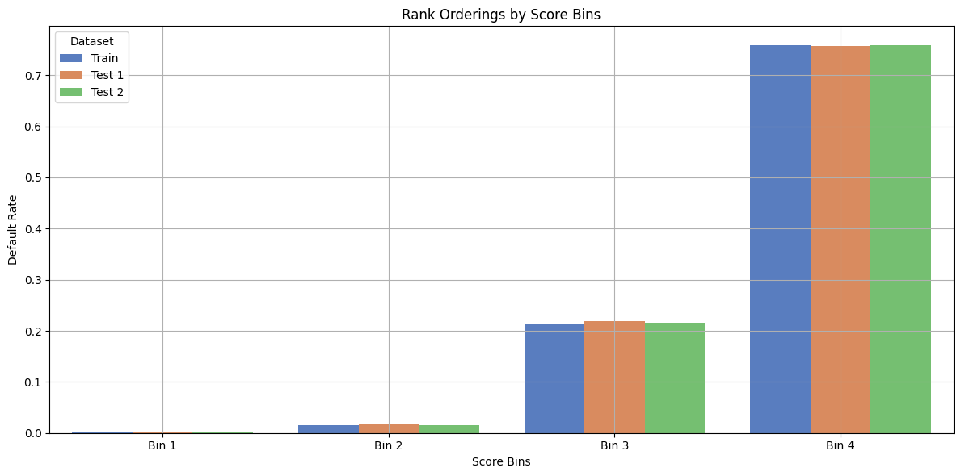
XGBOOST – FINAL MODEL

Slide 11
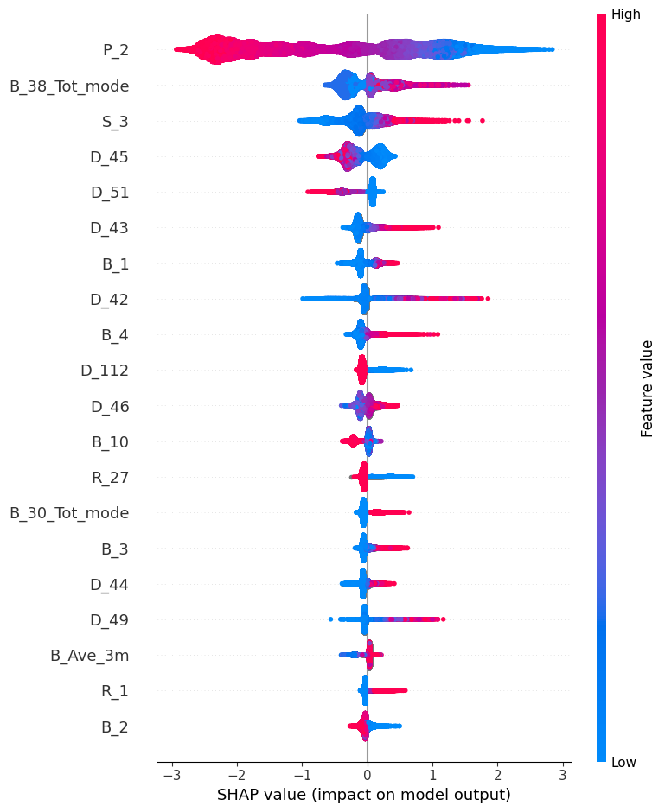
XGBOOST – SHAP ANALYSIS.
This chart basically tells us how each feature influences the probability of our prediction
Example:
P_2: We see as Payment related variable increases the probability of default decreases(Negative Correlation)
S_3: As the spend increases the probability of default increases. (Positive Correlation)

Slide 12
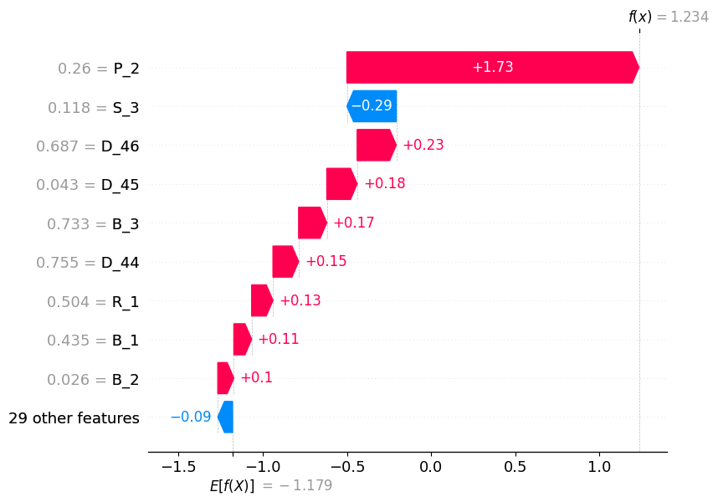
XGBOOST – SHAP ANALYSIS.
This chart basically tells us how each feature influences the probability of the prediction at each instance.
Example:
P_2: Increases the log odds of probability of default by 1.73 for the instance with index 14

Slide 13
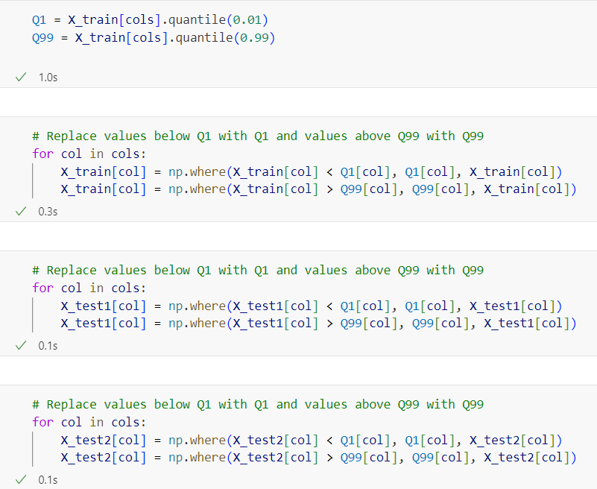
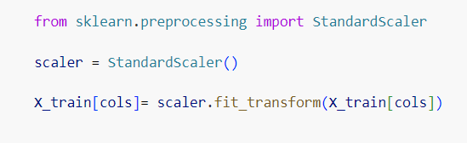
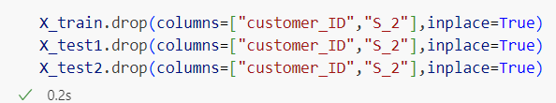
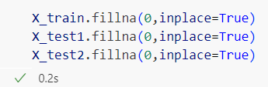
NEURAL NETWORK – DATA PROCESSING
Pre Processing Applied
Null -Value treatment
Outlier Removal
Normalization
Dropping unnecessary Features

Slide 14
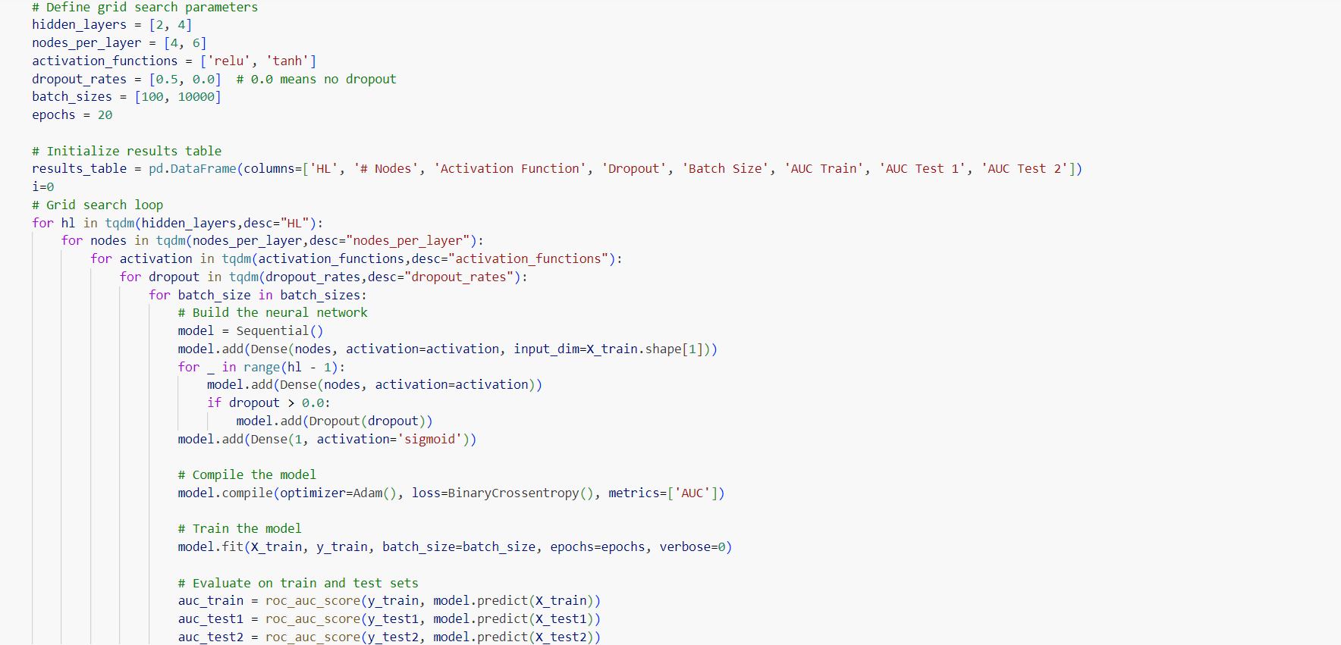
NEURAL NETWORK - GRID SEARCH

Slide 15
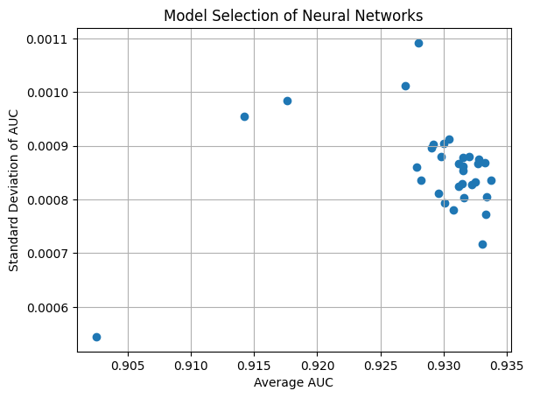
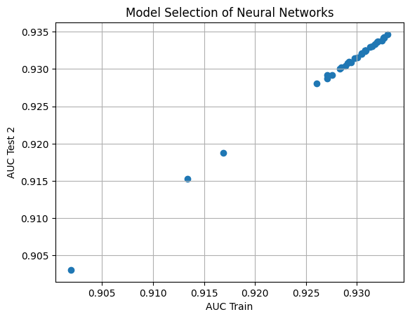
NEURAL NETWORK - GRID SEARCH

Slide 16
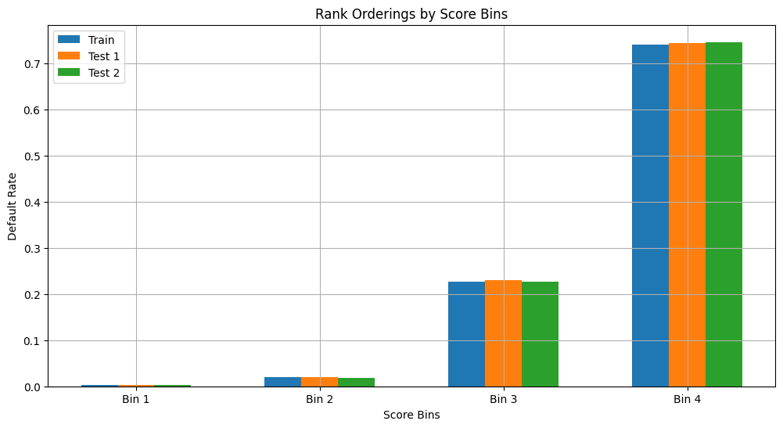
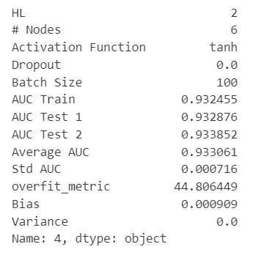
NEURAL NETWORK – FINAL MODEL

Slide 17

FINAL MODEL
BEST XGBOOST
BEST NN
Since the AUC values across all the data sets is better in the XGboost model, and it also happens to be a more simple and flexible model, we select “XGBOOST” as our final model

Slide 18
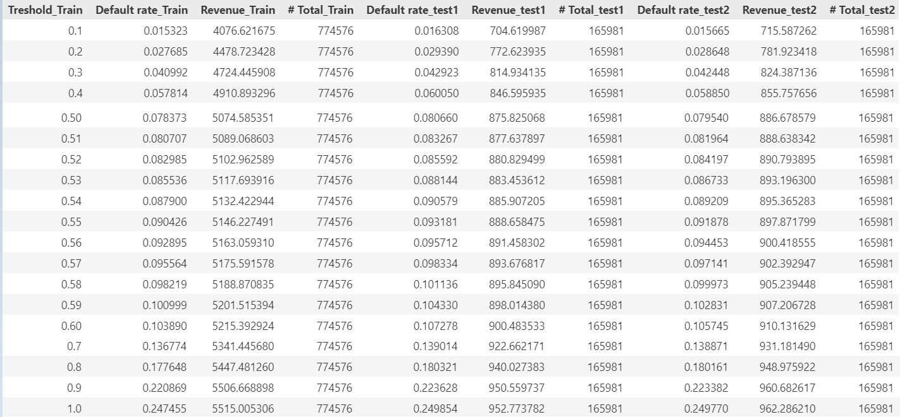
STRATEGY

